Slide 1

PBL Secondary Research
DDHDL Verilog– 22ECE42
IV Sem – Section A
Department of Electronics and Communications Engineering
Sl No. | USN | Name
1. | 4SO24EC042 | Hemanth Medu
2. | 4SO24EC033 | Ethan Ranger
3. | 4SO24EC030 | Dhathri PG
4. | 4SO24EC029 | Deeksha K

Slide 2
Problem Statement
Statement:
Real-time biomedical and environmental monitoring systems require efficient digital signal processing. Software-based FIR filtering can introduce latency and increased power consumption in wearable and IoT devices. Design and implement an FPGA-based hardware system capable of performing real-time digital filtering for streaming input data.

Slide 3
Objectives
The primary objective of this project is to develop an efficient FPGA-based digital filtering system capable of processing streaming input signals in real time.The design aims to overcome the limitations of conventional software-based filtering by leveraging parallel processing and pipelined architecture to achieve high-speed operation with minimal delay. A key goal is to implement a robust FIR filter structure using essential hardware components such as shift registers for storing past samples, coefficient ROM for predefined filter weights, multipliers for performing sample-coefficient operations, and adders for accumulating results.
Another important objective is to minimize power consumption while maintaining high performance, making the system suitable for portable and battery-operated devices like wearable health monitors and remote sensing units. The project also focuses on achieving efficient resource utilization within the FPGA, ensuring that logic elements, flip-flops, and DSP blocks are optimally used. Furthermore, the design is intended to be scalable and flexible, allowing the implementation of different types of filters such as low-pass, high-pass, and notch filters based on application requirements. Ultimately, the system aims to provide accurate noise removal, improved signal quality, and reliable real-time operation for both biomedical and environmental monitoring applications.

Slide 4
Review of existing work
Architecture Used:
Pipelined FIR Architecture (parallel MAC structure,3 stages pipeline structure).Uses shift registers (Z−1 delays) + multiplier–adder tree
Optimized with CSD/Distributed Arithmetic multipliers
Throughput Achieved:
High throughput due to parallel processing
One output sample per clock cycle (after pipeline fill)
Suitable for real-time ECG signals
Resource Utilization:
LUTs: Used for control logic, adders, and DA implementation
Flip-Flops (FFs): Used in pipeline registers and shift registers
DSP slices: Reduced usage (due to CSD/DA instead of full
multipliers)
Limitations:
Fixed coefficients (no adaptive filtering)
No input buffering (timing mismatch possible)
Moderate area usage due to multiple registers
Power optimization not considered
Limited noise/artifact handling for real ECG signals

Slide 5
Timeline
Timeline | Work Type
20/03/2026 - 27/03/2026 | Referring research papers
27/03/2026 - 04/04/2026 | Discussion about block and architecture diagram
05/04/2026 | Finalized and block and architecture diagram
09/04/2026 - 17/04/2026 | discussion about leaf cells
29/04/2026 - 02/05/2026 | Finalized leaf cells and simulated

Slide 6
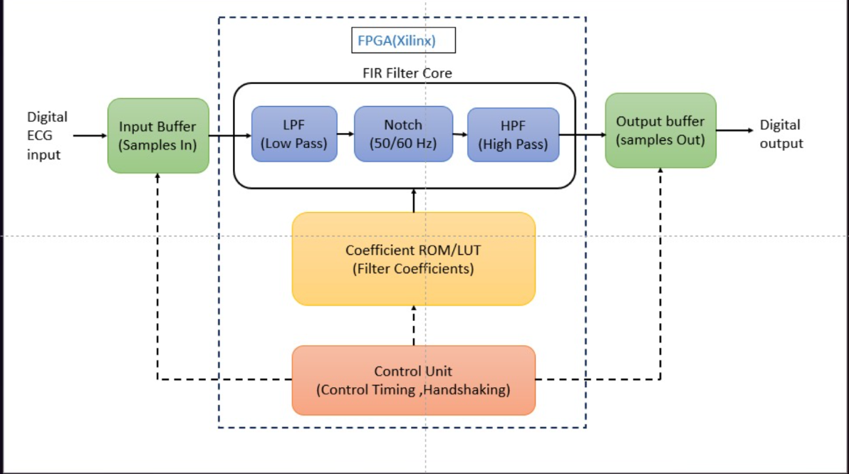
Block Diagram

Slide 7
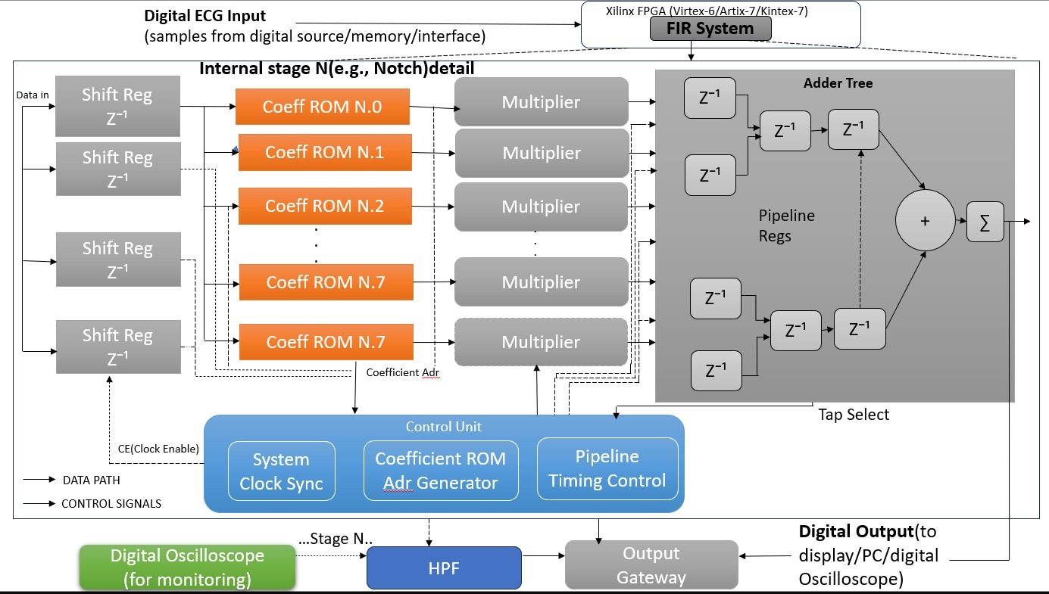
Architecture Diagram:(focused on notch filter)

Slide 8
Leaf Cells:
1.Shift Register Block (Z−1 delays):
Leaf cells:
D Flip-Flops (D-FFs)
Clock buffers
Enable logic (AND gates)
2. Coefficient ROM
Leaf cells:
Memory cells (ROM cells)
Address decoder
Word line & bit line drivers
Sense amplifiers
3. Multiplier Block
Leaf cells:
AND gates (partial product generation)
Adders (Half Adder, Full Adder)
Booth encoder
Shifter
4. Adder Tree (CSA / XOR-MUX)
Leaf cells:
Full Adders (FA)
Half Adders (HA)
XOR gates
Multiplexers (MUX)
Carry Save Adders (CSA units)

Slide 9
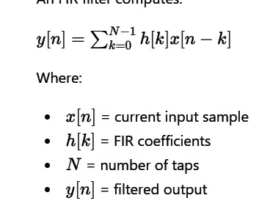
Main formula

Slide 10
Work Distribution
Name | Work
Hemanth Medu | 2 research papers, research gaps,design justification,introduction ,architecture diagram
Ethan Ranger | 2 research papers , comparison analysis,review of existing work,objectives, Block diagram
Dhathri PG | 2 research papers,leaf cells and simulation,block diagram (ppt)
Deeksha K | 2 research papers,finding leaf cells and simulation, architecture diagram(ppt)

Slide 11
References
[1] P. C. Bhaskar and M. D. Uplane, "FPGA Based Digital FIR Multilevel Filtering For ECG Denoising," in Proc. 2015 International Conference on Information Processing (ICIP), Vishwakarma Institute of Technology, Pune,India, Dec. 16–19, 2015, pp. 733–738.
[2] M. Prabhavathy and S. M. Sakthivel, "VLSI Implementation of CSD Based Efficient FIR Filter for ECG Signal Denoising," in Proc. 2024 IEEE 4th International Conference on VLSI Systems, Architecture, Technology and Applications (VLSI SATA), 2024, doi:0.1109/VLSISATA61709.2024.10560274.
[3] B. Sriram, A. V. Thanvi, B. V. V. Reddy, and V. B. K. L. Aruna,”Strategic Reduction of Area and Power in FIR Filter Architecture for ECG Signal Acquisition," in Proc. 2025 14th International Conference on System Modeling & Advancement in Research Trends (SMART), Teerthanker Mahaveer University, Moradabad, India, Nov. 14–15, 2025, pp. 574–578,doi: 10.1109/SMART66937.2025.11389312.
[4] R. Rasu, P. Shanmuga Sundaram, and N. Santhiyakumari, "FPGABased Non-Invasive Heart Rate Monitoring System for Detecting Abnormalities in Fetal," in Proc. 2015 International Conference on Space Science and Communication (SPACES), K L University, 2015, pp. 375–379.
[5] L. Nian-qiang, H. Si-Yu, and C. Shi-Yao, "Application of Distributed FIRFilter Based on FPGA in the Analyzing of ECG Signal," in Proc. 2010International Conference on Intelligent System Design and EngineeringApplication (ISDEA), 2010, pp. 335–338, doi: 10.1109/ISDEA.2010.265.

Slide 12
[6] B. Singh, R. Mehra, and Chandni, "Reconfigurable FIR Filter for Denoising of ECG Signal," in Proc. 2016 IEEE International Conference, NITTTR Chandigarh, India, 2016.
[7] S. Sumathi, A. Balaji Ganesh, S. Umakumari, H. Priyadharshini, and S.Srimathi, "Arrhythmia Detection and ECG Signal Analysis using Digital Filtering Techniques," in Proc. 7th International Conference on Communication and Electronics Systems (ICCES 2022), 2022, pp. 6–11,doi: 10.1109/ICCES54183.2022.9835793.
[8] T. Singh, P. Agarwal, and V. K. Pandey, "ECG Baseline Noise Removal Techniques Using Window Based FIR Filters," in Proc. 2014 International Conference on Medical Imaging, m-Health and Emerging Communication Systems (MedCom), Greater Noida, India, 2014, pp. 131–136.
Github: https://github.com/hemanthmedu/FIR-based-FPGA-Filters-.git

Slide 13
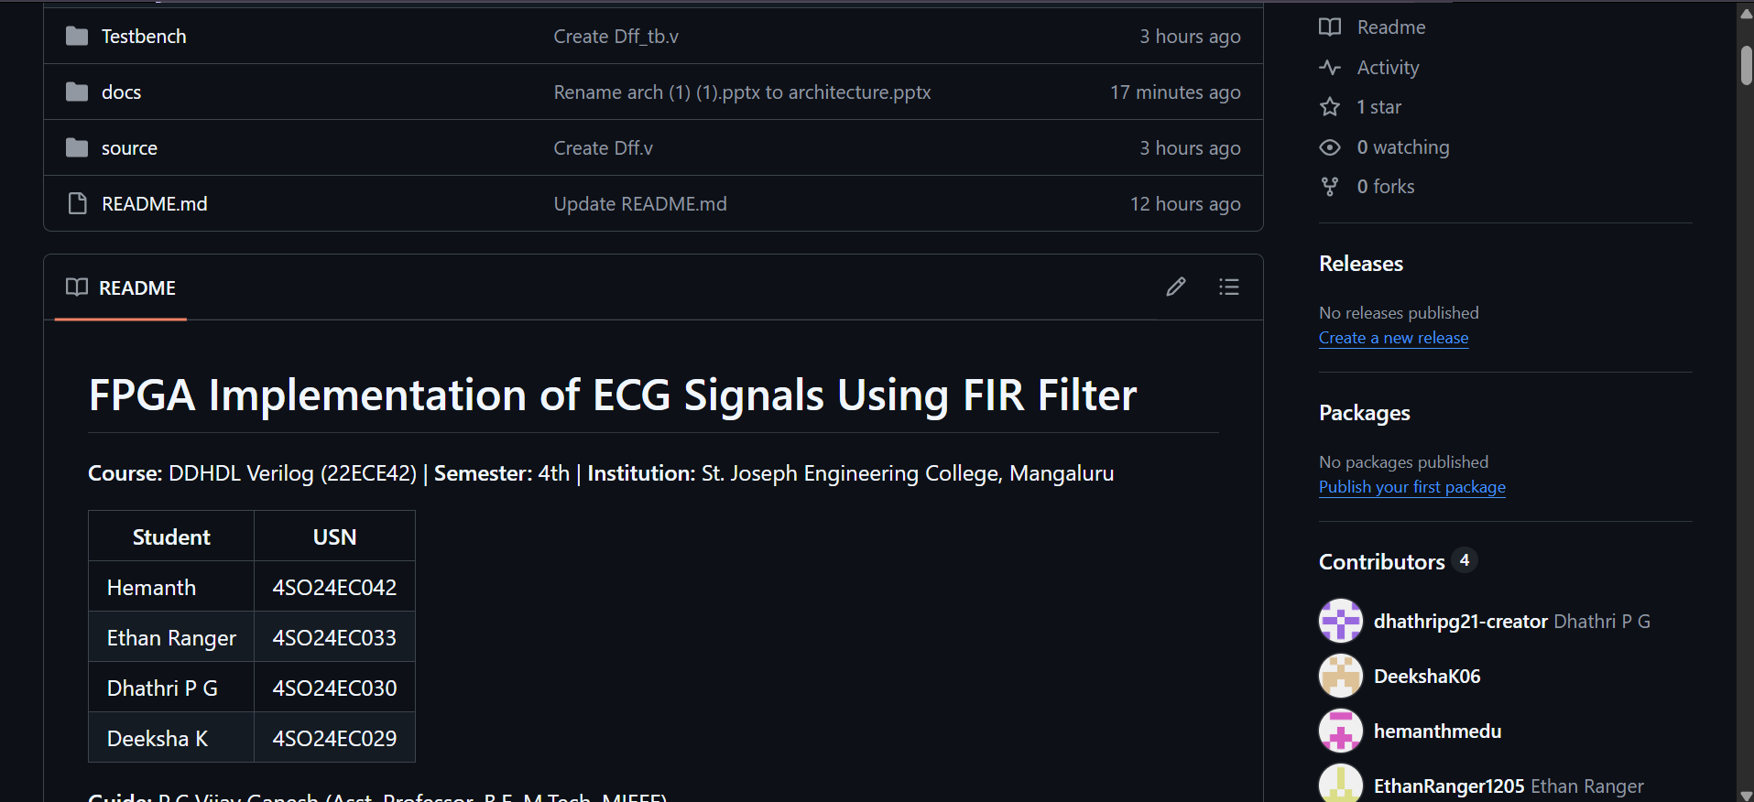
Github repository details

